Slide 1
Blacktown Chinese Christian Church
Welcome to Our English Service 02.03.2025
English Service 9:45 – 11:00 am
Worship Songs: Passage: Speaker: Topic: Response Song: Announcements and Closing Prayer Benediction
Cornerstone So Will I Build My Life Genesis 22: 1-18 TBA TBA TBA

Slide 2
BCCC english service

Slide 3

Please keep all phones on silent

Slide 4
Cornerstone
Edward Mote, Eric Liljero, Jonas Myrin, Reuben Morgan, William Batchelder Bradbury © 2011 Hillsong MP Songs (Admin. by Hillsong Music Publishing Australia) Hillsong Music Publishing UK (Admin. by Hillsong Music Publishing Australia) Hillsong Music Publishing Australia CCLI Licence No. 5485849 . CCLI Song number: 6158927

Slide 5
Verse 1
My hope is built on nothing less
Than Jesus blood and righteousness
I dare not trust the sweetest frame
But wholly trust in Jesus name (x2)

Slide 6
Chorus
Christ alone, Cornerstone
Weak made strong in the Saviour's love
Through the storm, He is Lord
Lord of all

Slide 7
Verse 2
When darkness seems to hide His face
I rest on His unchanging grace

Slide 8
Verse 2
In every high and stormy gale
My anchor holds within the veil
My anchor holds within the veil

Slide 9
Chorus
Christ alone, Cornerstone
Weak made strong in the Saviour's love
Through the storm, He is Lord
Lord of all

Slide 10
Post chorus
He is Lord, Lord of all

Slide 11
Chorus
Christ alone, Cornerstone
Weak made strong in the Saviour's love
Through the storm, He is Lord
Lord of all

Slide 12
Verse 3
When He shall come with trumpet sound
Oh may I then in Him be found
Dressed in His righteousness alone
Faultless stand before the throne

Slide 13
Chorus
Christ alone, Cornerstone
Weak made strong in the Saviour's love

Slide 14
Chorus
Through the storm, He is Lord
Lord of all
He is Lord, Lord of all

Slide 15
Chorus
Christ alone, Cornerstone
Weak made strong in the Saviour's love

Slide 16
Chorus
Through the storm, He is Lord
Lord of all
He is Lord, Lord of all

Slide 17
So Will I (100 Billion X)
Benjamin Hastings, Joel Houston, Michael Fatkin © 2017 Hillsong Music Publishing Australia CCLI Licence No. 5485849 . CCLI Song number: 7084123

Slide 18
Verse 1
God of creation
There at the start
Before the beginning of time

Slide 19
Verse 1
With no point of reference
You spoke to the dark
And fleshed out the wonder of light

Slide 20
Chorus 1
And as You speak
A hundred billion galaxies are born
In the vapour of Your breath, the planets form
If the stars were made to worship so will I

Slide 21
Chorus 1
I can see Your heart in everything You've made
Every burning star a signal fire of grace
If creation sings Your praises so will I

Slide 22
Verse 2
God of Your promise
You don't speak in vain
No syllable empty or void

Slide 23
Verse 2
For once You have spoken
All nature and science
Follow the sound of Your voice

Slide 24
Chorus 2
And as You speak
A hundred billion creatures catch Your breath
Evolving in pursuit of what You said
If it all reveals Your nature so will I

Slide 25
Chorus 2
I can see Your heart in everything You say
Every painted sky a canvas of Your grace
If creation still obeys You so will I

Slide 26
Bridge
If the stars were made to worship so will I
If the mountains bow in reverence so will I
If the oceans roar Your greatness so will I
For if everything exists to lift You high so will I

Slide 27
Bridge
If the wind goes where You send it so will I
If the rocks cry out in silence so will I
If the sum of all our praises still falls shy
Then we'll sing again a hundred billion times

Slide 28
Verse 3
God of salvation
You chased down my heart
Through all of my failure and pride

Slide 29
Verse 3
On a hill You created
The light of the world
Abandoned in darkness to die

Slide 30
Chorus 3
And as You speak
A hundred billion failures disappear
Where You lost Your life so I could find it here
If You left the grave behind You so will I

Slide 31
Chorus 3
I can see Your heart in everything You've done
Every part designed in a work of art called love
If You gladly chose surrender so will I

Slide 32
Chorus 3
I can see Your heart eight billion different ways
Every precious one a child You died to save
If You gave Your life to love them so will I

Slide 33
Tag
Like You would again a hundred billion times
But what measure could amount to Your desire
You're the One who never leaves the one behind

Slide 34
Build My Life
Brett Younker, Karl Martin, Kirby Kaple, Matt Redman, Pat Barrett © 2016 Martin, Karl Andrew (Admin. by Sentric Music) Bethel Music Publishing (Admin. by SHOUT! Music Publishing Australia) Capitol CMG Genesis (Admin. by SHOUT! Music Publishing Australia) Housefires Sounds (Admin. by SHOUT! Music Publishing Australia) Kaple Music (Admin. by SHOUT! Music Publishing Australia) Said And Done Music (Admin. by SHOUT! Music Publishing Australia) sixsteps Music (Admin. by SHOUT! Music Publishing Australia) Thankyou Music (Admin. by SHOUT! Music Publishing Australia) Vamos Publishing (Admin. by SHOUT! Music Publishing Australia) worshiptogether.com songs (Admin. by SHOUT! Music Publishing Australia) CCLI Licence No. 5485849 . CCLI Song number: 7070345

Slide 35
Verse 1
Worthy of every song we could ever sing
Worthy of all the praise we could ever bring
Worthy of every breath we could ever breathe
We live for You

Slide 36
Verse 2
Jesus, the name above every other name
Jesus, the only one who could ever save
Worthy of every breath we could ever breathe
We live for You

Slide 37
Chorus
Holy, there is no one like You
There is none beside You
Open up my eyes in wonder

Slide 38
Chorus
Show me who You are
And fill me with Your heart
And lead me in Your love to those around me

Slide 39
Verse 3
Worthy of every song we could ever sing
Worthy of all the praise we could ever bring
Worthy of every breath we could ever breathe
We live for You

Slide 40
Verse 4
Jesus, the name above every other name
Jesus, the only one who could ever save
Worthy of every breath we could ever breathe
We live for You

Slide 41
Chorus
Holy, there is no one like You
There is none beside You
Open up my eyes in wonder

Slide 42
Chorus
Show me who You are
And fill me with Your heart
And lead me in Your love to those around me

Slide 43
Chorus
Holy, there is no one like You
There is none beside You
Open up my eyes in wonder

Slide 44
Chorus
Show me who You are
And fill me with Your heart
And lead me in Your love to those around me

Slide 45
Bridge
I will build my life upon Your love
It is a firm foundation
I will put my trust in You alone
And I will not be shaken (x2)

Slide 46
Chorus
Holy, there is no one like You
There is none beside You
Open up my eyes in wonder

Slide 47
Chorus
Show me who You are
And fill me with Your heart
And lead me in Your love to those around me

Slide 48
Chorus
Holy, there is no one like You
There is none beside You
Open up my eyes in wonder

Slide 49
Chorus
Show me who You are
And fill me with Your heart
And lead me in Your love to those around me

Slide 50
Bridge
I will build my life upon Your love
It is a firm foundation
I will put my trust in You alone
And I will not be shaken

Slide 51
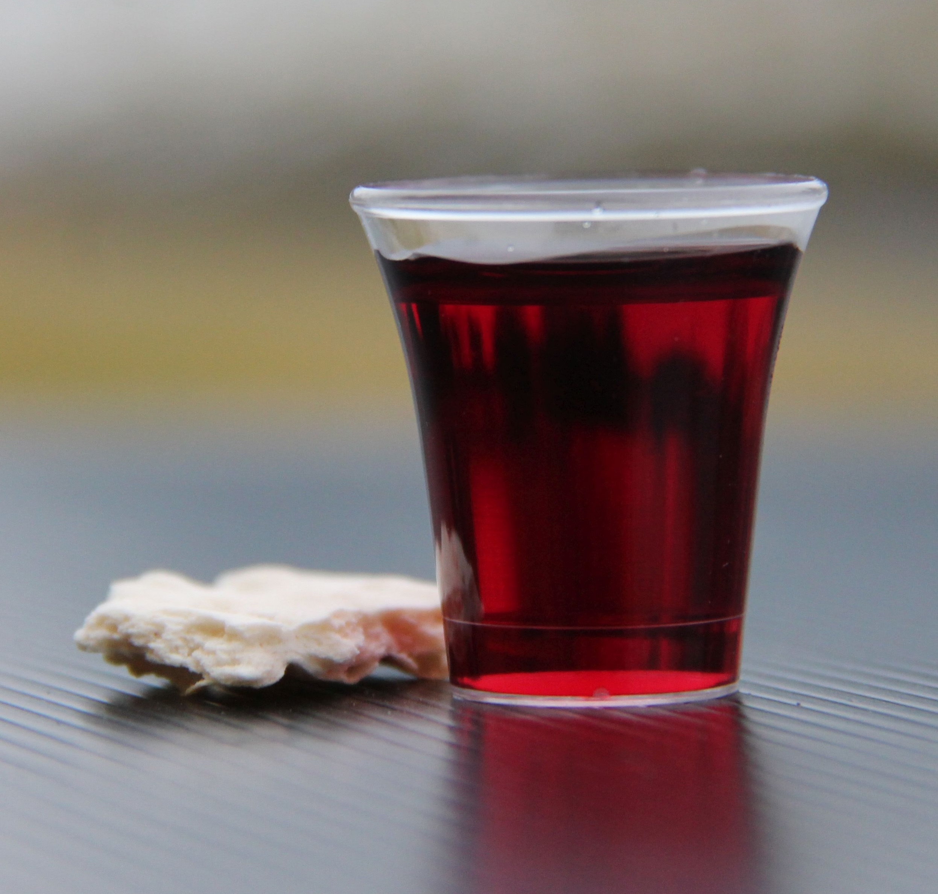
Holy Communion

Slide 52
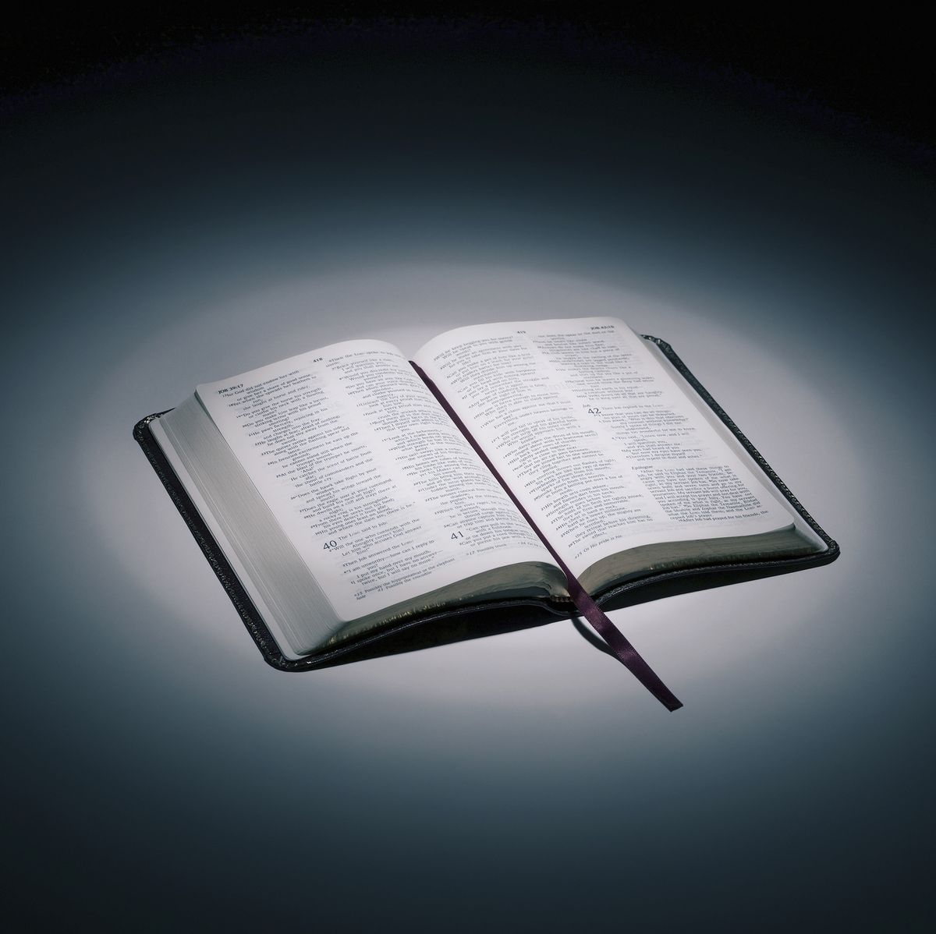
Bible reading

Slide 53
Genesis 22: 1-18 (NIV)
Some time later God tested Abraham. He said to him, “Abraham!”
“Here I am,” he replied.
² Then God said, “Take your son, your only son, whom you love—Isaac—and go to the region of Moriah. Sacrifice him there as a burnt offering on a mountain I will show you.”

Slide 54
Genesis 22: 1-18 (NIV)
³ Early the next morning Abraham got up and loaded his donkey. He took with him two of his servants and his son Isaac. When he had cut enough wood for the burnt offering, he set out for the place God had told him about. ⁴ On the third day Abraham looked up and saw the place in the distance.

Slide 55
Genesis 22: 1-18 (NIV)
⁵ He said to his servants, “Stay here with the donkey while I and the boy go over there. We will worship and then we will come back to you.”
⁶ Abraham took the wood for the burnt offering and placed it on his son Isaac, and he himself carried the fire and the knife. As the two of them went on together,

Slide 56
Genesis 22: 1-18 (NIV)
⁷ Isaac spoke up and said to his father Abraham, “Father?”
“Yes, my son?” Abraham replied.
“The fire and wood are here,” Isaac said, “but where is the lamb for the burnt offering?”
⁸ Abraham answered, “God himself will provide the lamb for the burnt offering, my son.” And the two of them went on together.

Slide 57
Genesis 22: 1-18 (NIV)
⁹ When they reached the place God had told him about, Abraham built an altar there and arranged the wood on it. He bound his son Isaac and laid him on the altar, on top of the wood. ¹⁰ Then he reached out his hand and took the knife to slay his son.

Slide 58
Genesis 22: 1-18 (NIV)
¹¹ But the angel of the Lord called out to him from heaven, “Abraham! Abraham!”
“Here I am,” he replied.
¹² “Do not lay a hand on the boy,” he said. “Do not do anything to him. Now I know that you fear God, because you have not withheld from me your son, your only son.”

Slide 59
Genesis 22: 1-18 (NIV)
¹³ Abraham looked up and there in a thicket he saw a ram caught by its horns. He went over and took the ram and sacrificed it as a burnt offering instead of his son. ¹⁴ So Abraham called that place The Lord Will Provide. And to this day it is said, “On the mountain of the Lord it will be provided.”

Slide 60
Genesis 22: 1-18 (NIV)
¹⁵ The angel of the Lord called to Abraham from heaven a second time ¹⁶ and said, “I swear by myself, declares the Lord, that because you have done this and have not withheld your son, your only son,

Slide 61
Genesis 22: 1-18 (NIV)
¹⁷ I will surely bless you and make your descendants as numerous as the stars in the sky and as the sand on the seashore. Your descendants will take possession of the cities of their enemies, ¹⁸ and through your offspring all nations on earth will be blessed, because you have obeyed me.”

Slide 62
Scripture quotations taken from The Holy Bible, New International Version® NIV®
Copyright © 1973, 1978, 1984, 2011 by Biblica, Inc.
Used with permission. All rights reserved worldwide.

Slide 63
Announcements

Slide 64





Account name: Blacktown Chinese Christian Church
Account number: 4216 50263
Offering
BSB: 112 - 879
Please put in "offering" as the reference
The offering box is available at the back of the hall

Slide 65
Prayer points

Slide 66
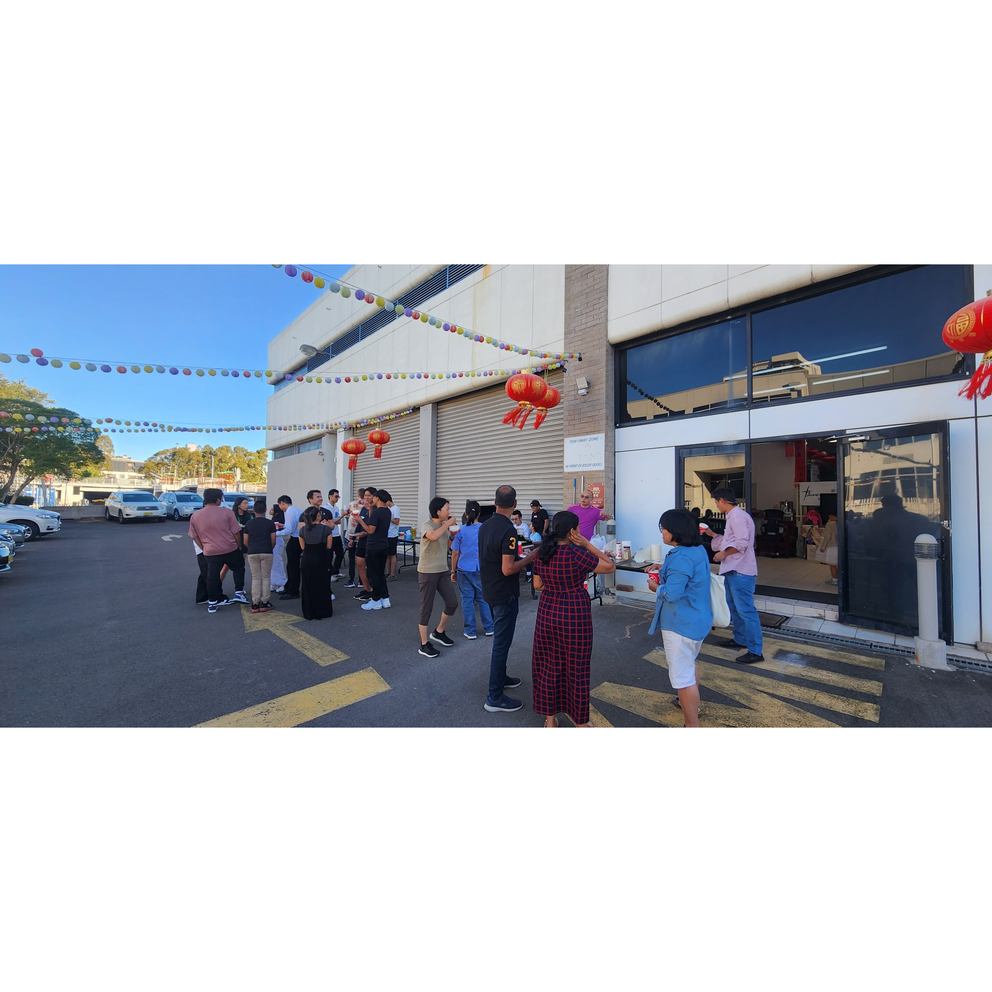
Mingle time!

